Slide 1
SPS110
Strategic Problem Solving

Slide 2
Problem solving

Slide 3
Problem solving in it
What’s at stake?
Time
Money
Customer Satisfaction
Potentially safety

Slide 4
Problem solving in it
Expectations in an IT Environment
Think intelligently, quickly, and efficiently
Provide multiple solutions to any given problem
Implement solutions as per guidelines of your manager or supervisor
Work independently and make appropriate decisions in a time crunch
DOCUMENTATION

Slide 5
Problem solving in it
What is a “Problem”
Problem – “A situation that confronts an individual or group of individuals, which requires and for which no apparent path or resolution is readily obvious.”
Examples: obstacles, discrepancies, difficulties, deviations

Slide 6
Problem solving in it
What is “Problem Solving”?
The ability to get answers using a conscious, organized process
A systematic approach to utilizing multiple perspectives to uncover issues related to a particular problem, design a plan, and evaluate the outcome
A process in which knowledge, skills, and understanding are applied to achieve a desired outcome
A high-order cognitive process that requires control of routine and fundamental skills
A series of decisions
Part of a larger process that includes problem finding and problem shaping

Slide 7
Problem solving in it
What is “Problem Solving”?
Problem solving occurs when we need to move past an obstacle or difficulty from an undesirable state to a desired state
Current
State
Obstacle/
Difficulty
Desired State

Slide 8
Problem solving in it
Problem Solving Terminology
Purpose – What we want to do or what we want to be
Situation – The circumstances we exist in (whether good or bad)
Problem – An aspect of our situation which conflicts with our purpose
Cause – What brings about the problem
Solvable Cause – Causes that we have the power/control to change or affect
Solution – A specific action to solve a problem

Slide 9
Problem solving in it
Well-structured vs Ill-Structured Problems
Well Structured Problems:
Defined thoroughly
Fairly obvious and logical solution
Stated and measured constraints
Ill-Structured Problems:
Vague or not properly defined
Solutions are unpredictable with multiple solutions and solution paths
Constraints are not defined

Slide 10
Problem solving in it
Simple vs Complex Problems
Simple Problems:
Well defined and well-structured problem with a specific solution that can be worked out
Complex Problems:
No defined structure or form (a mess)
Must be structured or molded by problem solver(s) before problem can be properly solved

Slide 11
Problem solving in it
Inefficiencies
Too many, too few resources
Out-of-date technology
Wastage
Under utilized resources
Types of Problems
Blocks
Power cable missing
Instructions unavailable
Mistakes
Switch put in incorrect position
Server configured incorrectly
Breakdowns
Power failure
Network outage

Slide 12
The problem solving method
Define the Problem
Determine the Causes
Generate Ideas
Select the Best Solution
Action
Documentation*

Slide 13
The problem solving method
Defining the Problem
What is happening?
Where is it happening?
When did the problem start?
Who is affected by the problem?

Slide 14
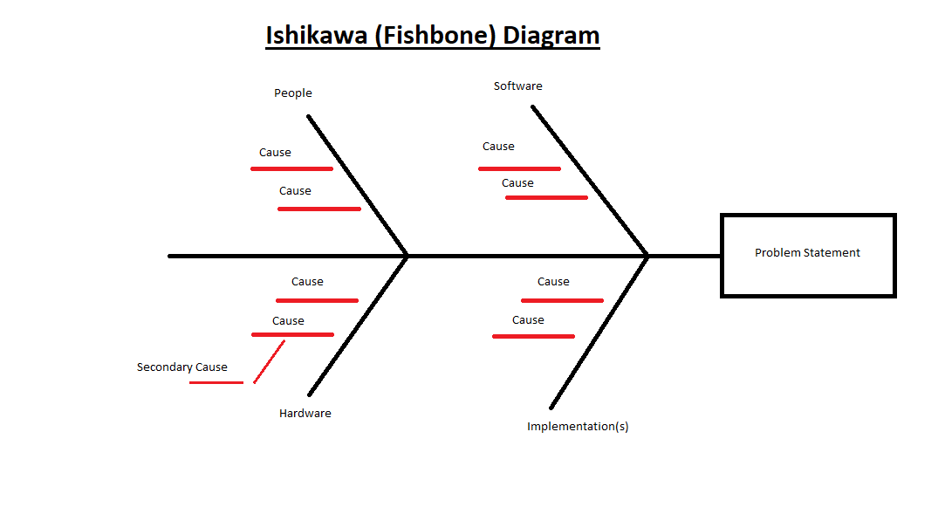
The problem solving method
Determine Causes
Why is this happening?

Slide 15
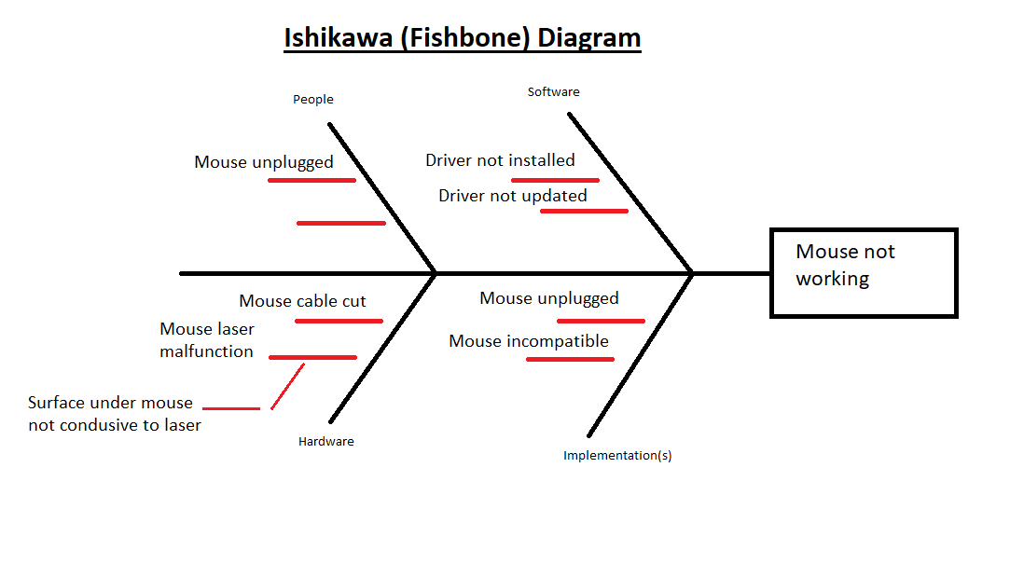
The problem solving method
Example

Slide 16
The problem solving method
Generate Ideas about problem, potential causes, potential solutions
Mind Mapping
Cost?
backup
New Mouse
Install or update drivers
Online or local?
Compatibility?
Mouse not working
Down time
Clean surface under mouse
Plug in or re plug in mouse
Port failure?
Document
Process
Human
factor

Slide 17
The problem solving method
Select the Best Solution
What is the best solution to the most likely cause of the problem?
Factors to consider:
Time, money, manpower, downtime, specific needs of company
Weigh the pros and cons of any given solution
Judge the implementation costs (time and money)

Slide 18
The problem solving method
Trade-off analysis
If we use solution A, we gain X but lose Y
If we use solution B, we gain Y but lose X
Example – Broken Mouse
We could repair the mouse and lose the time that is taken to fix it but we save the cost of purchasing a new mouse
We could buy a new mouse and save the time it takes to repair the old one but we lose the money needed to purchase the new mouse.

Slide 19
The problem solving method
Action
Flowchart your implementation
Mouse
Works?
Start
Repair Mouse
Yes
End
No
Replace Mouse

Slide 20
The problem solving method
Documentation
EVERYTHING should be documented - the problem, the process, the solution, and the implementation.
This makes it easier for you and your coworkers in the future.

